Slide 1
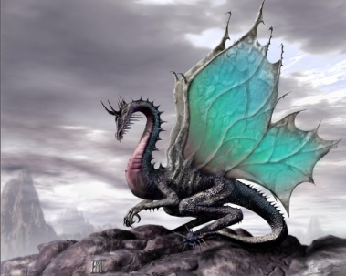
What Makes A Story?
By Louise Marley
2013
Louise Marley: Home
Notes:
Although stories can be about all sorts of different things, there are some elements all good stories have.

Slide 2
Conflict
Every story has conflict of some kind. It can be external, like Frodo Baggins fighting Gollum for the Ring.
It can be internal, as when Brian, in The Hatchet, fights with himself over surviving or dying.
It can be the grand battle between good and evil. Can you think of examples from stories you like?

Slide 3
Climax
The climax is the most dramatic point of a story, the place at which everything comes together.
The climax is a result of conflicts building to a high point of tension, so that something dramatic happens.
You always know when you’ve reached this point in a movie, because that’s when the music is the loudest and the scariest!

Slide 4
Resolution
The resolution is what happens in a story after the climax. Some stories simply stop.
Others continue, resolving small plot points and giving the reader an idea of what the characters might do next. “Cinderella” is a good example.
The story could stop after Cinderella puts on the glass slipper, but it doesn’t. What is the resolution?

Slide 5
Character Change
The events of a story bring about changes in the characters.
Luke Skywalker becomes a brave warrior. Harry Potter learns to use his power as a wizard.
In Beauty and the Beast, the Beast changes enormously, both inside and outside.

Slide 6
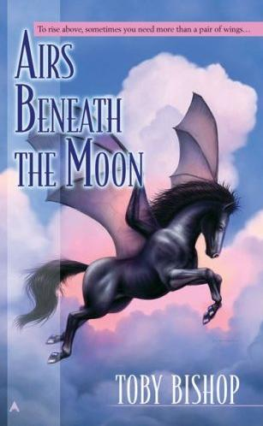
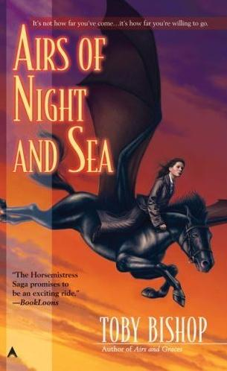
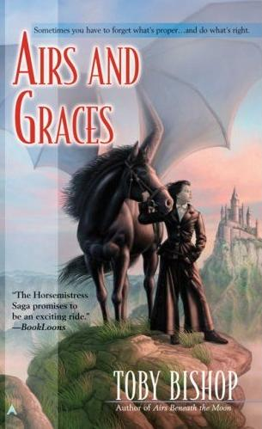
Beginning Middle End
A story has a shape, in the same way a song does, or a painting, or a sculpture.
The beginning of it introduces us to the characters and the situation.
The middle develops the plot, and builds to the climax.
The end is when everything is over, whether it’s a happy ending or a tragic one.
All three of these elements give the story its shape. We call this structure.

Slide 7
Meet Louise Marley
I love to visit middle schools and high schools to talk about writing and about speculative fiction. I appreciate e-mails and notes from readers. I also love conventions, and the fans who attend them. They give me inspiration, input, community, and friendship.
I’m fortunate to live in the Pacific Northwest, with my husband and son and Scottish Terrier, where there is an abundance of resources for writers.
I love rambling at the dog park with my Scottie, Piper, and I love writing. I still read for pleasure, because I think if I don’t read for fun, I won’t write for fun. Books should be fun!

